Slide 1
Can a Machine Be Racist or Sexist?
On Social Bias in Machine Learning
Renée M. P. Teate
HelioCampus
Notes:
https://www.heliocampus.com/

Slide 2
What comes to mind for most people when they are asked about their fears related to “Artificial Intelligence” or “Machine Learning”?

Slide 3
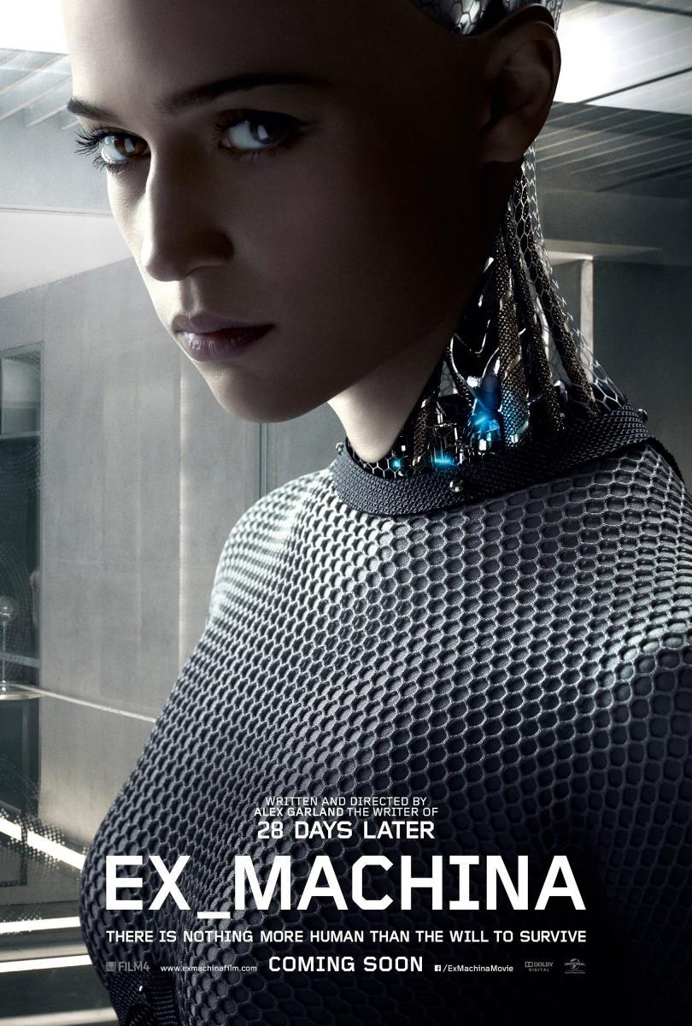
Los Exterminadores De Skynet (Terminator) by Hersson Piratoba on Flickr
Ex Machina from film affinity
EXPOSYFY I, Robot by Urko Dorronsoro from Donostia via Wikimedia Commons

Slide 4
So what is already going on
with AI and Machine Learning that should concern us?

Slide 5
And are the impacted people and communities aware of what’s already happening?
Are the people who design these systems aware of the possible impacts of their work on people’s lives as they design and deploy data products?
Notes:
These are the questions that inspired me to write this talk

Slide 6
“But if we take humans out of the loop and leave decisions up to computers, won’t it reduce the problems inherent in human decision-making?”

Slide 7
Can a Machine Be Racist or Sexist?
Notes:
Which brings us to the central question of this talk...

Slide 8
Can a Machine Learning Model Be Trained to Be
Racist or Sexist (or made biased or injust in other ways -- intentionally or not)?

Slide 9
Let’s define

Slide 10
Machine [Algorithm]
“a step-by-step procedure for solving a problem”
Merriam-Webster Dictionary
Notes:
Set of logical steps run by a computer

Slide 11
Racism
“racial prejudice or discrimination”
“a belief that race is the primary determinant of human traits and capacities and that racial differences produce an inherent superiority of a particular race”
Merriam-Webster Dictionary

Slide 12
Racism
“a doctrine or political program based on the assumption of racism and designed to execute its principles”
[or, not designed NOT to execute its principles!]

Slide 13
Sexism
“prejudice or discrimination based on sex”
“behavior, conditions, or attitudes that foster stereotypes of social roles based on sex”
Merriam-Webster Dictionary

Slide 14
Institutional or Systemic Racism and Sexism
a system that codifies and perpetuates discrimination against individuals or communities based on their race or sex
(note: these systems are designed/engineered by people)

Slide 15
Statuses Protected by Laws in the U.S.
Race
Sex
Religion
National Origin
Age
Disability Status
Pregnancy
Citizenship
Familial Status
Veteran Status
Genetic Information
Notes:
https://en.wikipedia.org/wiki/Protected_group
Various laws to protect people from discrimination based on status in these categories

Slide 16
Example: Bank Loans Before Machine Learning
Bank officer deciding whether to give a loan, assessing likelihood to repay:
Employment Status and History
Amount of Debt and Payment History
Income & Assets
“Personal Character”
Co-Signer
References
Credit Score
Based on amount of debt, credit card payment history, debt-credit ratio etc.
May seem fair, but remember things like on-time payment of rent not included
Feedback loop - no/bad credit history, can’t get credit, high interest, can’t improve credit score
Is somewhat transparent, and errors can be corrected
Notes:
Credit report can be contested/corrected

Slide 17
Example: Bank Loans With Machine Learning
Algorithm assessing likelihood to repay:
Employment Status and History
Amount of Debt and Payment History
Income & Assets
“Personal Character”
Co-Signer
References
Credit Score
Detailed Spending Habits
Expenditures per month
Where you shop
Bill payment patterns
Where You Live
Social Media Usage
Time You Wake Up
Workout Consistency
Driving Habits
Time Spent Playing Video Games
Favorite Music
Browser History
Facebook Friends’ Financial Status
etc etc etc
Notes:
Who knows what fields they use… throwing examples out there from social media & devices

Slide 18
Is it fair for your interest rate, or whether you even get a loan offer, to be based on the default rates of “similar” people who, for instance, listen to the same kind of music as you?

Slide 19
What does it mean for decisions to become increasingly data-driven and automated?
We’re still making the same types of decisions (Who should receive funds from government programs? Who is at risk of dropping out of a university, and how do we intervene? What medical treatment should be applied based on a set of symptoms? Where should we locate the next branch of our business? etc etc), but now we’re using much more data, and programming computers to help us find patterns from datasets larger than humans could sensibly process.

Slide 20
If designed well, machine learning systems can improve our world!
Better more targeted answers faster!
More efficient use of taxpayer dollars, students receiving financial aid and intervention tutoring to help keep them in school, highly customized medical treatments, lower-risk business decisions!

Slide 21
But we have to keep in mind that now:
“...we have the potential to make bad decisions far more quickly, efficiently, and with far greater impact than we did in the past”
-Susan Etlinger, 2014 TED Talk

Slide 22
How can human biases get into a machine learning model?
Let’s explore how machine learning systems are designed and developed

Slide 23
Some Types of Machine Learning Models

Slide 24
Regression
What output value do we expect an input value to translate to?

Slide 25
Notes:
Home square ft vs home price

Slide 26
Notes:
Computer will adjust slope and intercept to reduce error – explain error

Slide 27
Notes:
Now we have our linear model of this data

Slide 28
Notes:
New input - new home on the market w/square feet

Slide 29
Notes:
New predicted output - home price

Slide 30
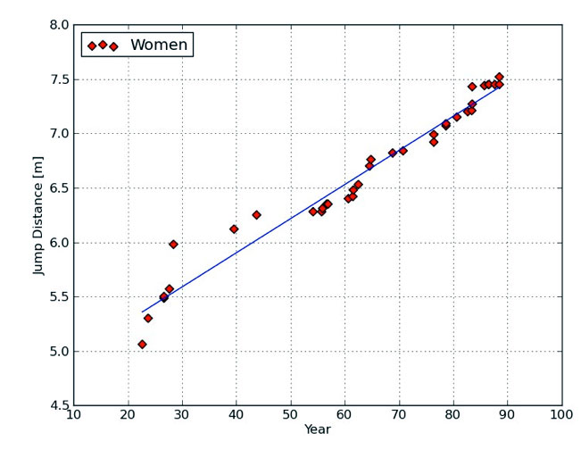
Forecasting Record-Breaking Long Jump Distance by Year
“Olympics Physics: The Long Jump and Linear Regression” https://www.wired.com/2012/08/physics-long-jump-linear-regression/

Slide 31
Predicting Natural Disaster Damage by Counting Relevant Social Media Posts
“Rapid assessment of disaster damage using social media activity” http://advances.sciencemag.org/content/2/3/e1500779/tab-figures-data
Notes:
Consider how this could be problematic – distribution of device ownership, impact of power outages on ability to tweet, etc.

Slide 32
Classification
Which group does X belong to?

Slide 33
Variable 1
<= 10
> 10
Variable 2
Variable 2
Category A
Category B
Category A
Category B
Notes:
Decision Tree classifier – classes can be likely to repay loan and not likely to repay loan, for instance.

Slide 34
Notes:
Supervised learning

Slide 35
Notes:
Model to separate classes (here in 2 dimensions)

Slide 36
Notes:
New data point, classifier puts it in “likely to repay” group

Slide 39
Notes:
Now modeling distribution of points

Slide 40
Notes:
Same new data point, classifier puts it in “not likely to repay” group

Slide 43
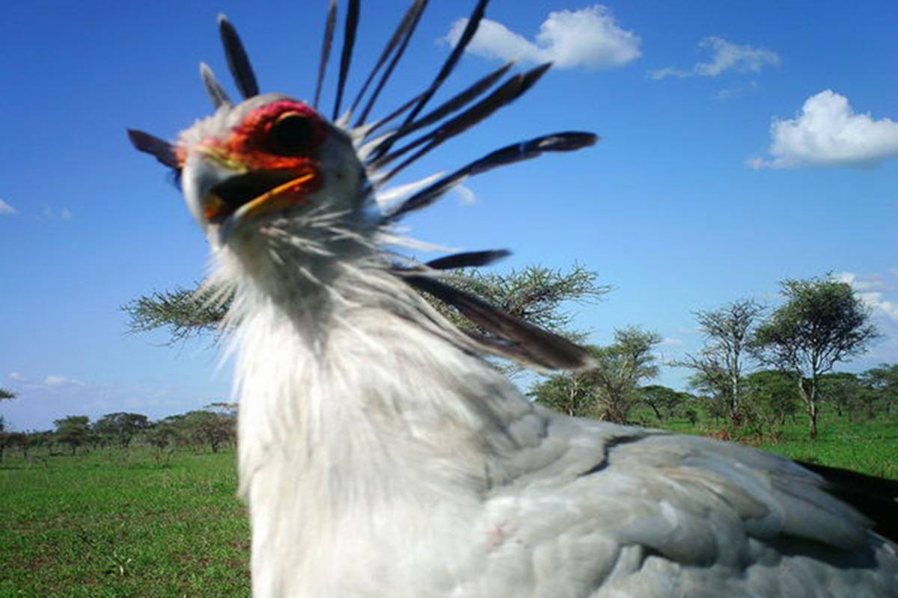
Is there an animal in this camera trap image?
“Deep learning tells giraffes from gazelles in the Serengeti” https://www.newscientist.com/article/2127541-deep-learning-tells-giraffes-from-gazelles-in-the-serengeti/
https://creativecommons.org/licenses/by-nc-sa/3.0/
Notes:
Hundreds of thousands of camera trap images, scientists can’t go through them all manually, used to crowdsource, now algorithm identifies which ones contain animals (or even which animals are likely pictured)
https://www.newscientist.com/article/2127541-deep-learning-tells-giraffes-from-gazelles-in-the-serengeti/

Slide 44
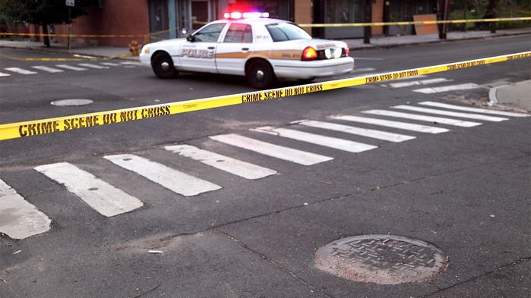
Is a crime scene gang-related?
“Artificial intelligence could identify gang crimes—and ignite an ethical firestorm” http://www.sciencemag.org/news/2018/02/artificial-intelligence-could-identify-gang-crimes-and-ignite-ethical-firestorm
ISTOCK.COM/DENISTANGNEYJR
Notes:
When to bring in community gang task force – what fields might be used? How might this be problematic?
http://www.sciencemag.org/news/2018/02/artificial-intelligence-could-identify-gang-crimes-and-ignite-ethical-firestorm

Slide 45
Clustering
How should we group this data?

Slide 46
Notes:
How do we find groups of “similar” items?

Slide 47
Notes:
3 clusters – maybe segmenting customers

Slide 49
Notes:
Same data, 5 clusters

Slide 51
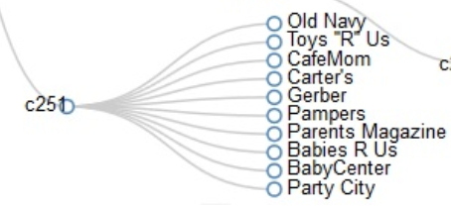
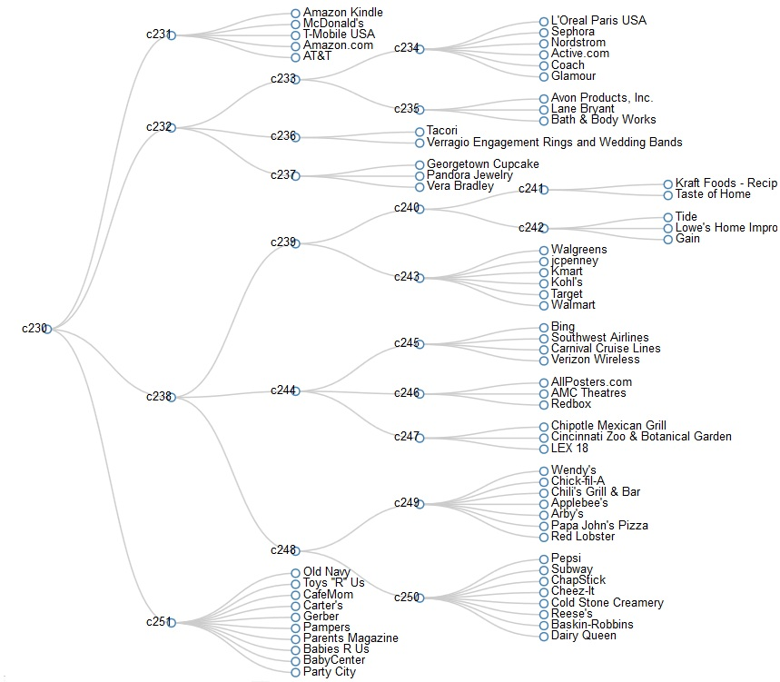
How might we segment our customers?
“Understanding, Analyzing, and Retrieving Knowledge from Social Media” http://cucis.ece.northwestern.edu/projects/Social/
Notes:
New parent cluster
http://cucis.ece.northwestern.edu/projects/Social/

Slide 52
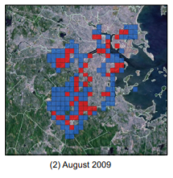
Which neighborhoods are most likely to experience home burglaries this month?
“Crime Forecasting Using Spatio-Temporal Pattern with Ensemble Learning” https://www.cs.umb.edu/~csyu/YU_resume%202016_01_08_files/yuPAKDD2014.pdf
Notes:
Might data collection from existing policing patterns bias this model?
https://www.cs.umb.edu/~csyu/YU_resume%202016_01_08_files/yuPAKDD2014.pdf

Slide 53
Artificial Neural Networks
Reinforcement Learning
Collaborative Filtering
etc.
Notes:
Some other types of machine learning algorithms

Slide 54
The purpose of most of these algorithms is to find patterns, trends, group things that are similar... In other words, we’re basically asking the computer to use lots of information to make generalizations, or stereotype.
Notes:
Can you call it stereotyping if there are 50 input variables? Definition is “simplified” view.

Slide 55
Predictive Model Development Process
Notes:
Example of how each of these is developed

Slide 56
Predictive Model Development
Deciding what you’re predicting / optimizing for
Data collection and storage
Data cleansing/preparation
Feature selection & engineering
Importing data into different algorithmic models
Training & Testing
Model evaluation & competition; Deciding what qualifies as a “good model”
Parameter Tuning, Cost function, Selecting cutoff values or stopping conditions, etc
“Productionizing” - Applying to live data, building interactive reports for end-users, explaining what the results mean and how to use them to make decisions
Monitoring, Improving, and Re-training over time
Notes:
***Humans are making decisions at every step***

Slide 57
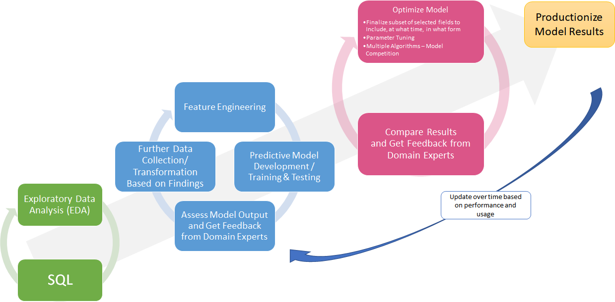

Slide 58
Where within this process can social biases be introduced?

Slide 59
Data Collection: Incorrectly Recorded
Notes:
Blamed a glitch in the in-car computer system where data was entered
http://www.kxan.com/news/local/austin/hearing-focuses-on-dps-troopers-wrongly-recording-drivers-race/994992819

Slide 60
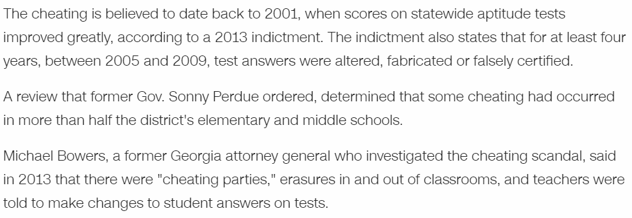
Data Collection: Manipulated
Notes:
https://www.cnn.com/2015/04/14/us/georgia-atlanta-public-schools-cheating-scandal-verdicts/index.html

Slide 61
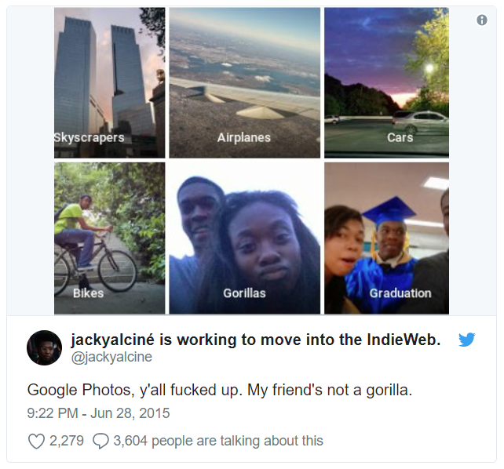
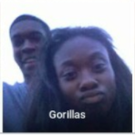
Data Collection: Not Representative
Notes:
Google Photos labeled this person’s friends as gorillas.
most likely, training data didn’t contain enough examples of African American faces (or, as Ines added, maybe the model doesn’t actually work well at all)
https://www.theverge.com/2018/1/12/16882408/google-racist-gorillas-photo-recognition-algorithm-ai

Slide 62
Update...
Notes:
They “solved” by removing the gorilla label (so now nothing can be labeled as a gorilla) instead of fixing their dataset and training so it didn’t label people as animals

Slide 63
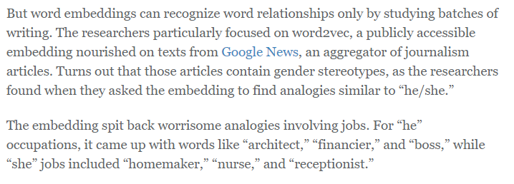
Data Collection: Contains Historic Biases
Notes:
https://www.bu.edu/today/2016/sexist-computer/
The word embeddings based on text over time were actually used to track the changes in how people were commonly stereotyped, by decade
http://www.sciencemag.org/news/2018/04/artificial-intelligence-reveals-how-us-stereotypes-about-women-and-minorities-have
https://www.technologyreview.com/s/602025/how-vector-space-mathematics-reveals-the-hidden-sexism-in-language/

Slide 64
Data Availability: Imbalanced Dataset
Notes:
Vast majority of dataset represents “majority” class - Fraud detection – millions of good transactions, few fraudulent
Label everything as not fraudulent, can have a high accuracy, but doesn’t find the fraud

Slide 65
Model Evaluation: Confusion Matrix & Cost
Accuracy
If 99 people out of 100 don’t have cancer, and there is a test that just always comes back negative (predicts that no one has cancer), that test is still 99% accurate
 | Has Cancer | Does Not Have Cancer
Tests Positive for Cancer | TRUE POSITIVE | FALSE POSITIVE
Tests Negative for Cancer | FALSE NEGATIVE | TRUE NEGATIVE
Notes:
Explain each part of the grid (green classified correctly)

Slide 66
Model Evaluation: Confusion Matrix & Cost
 | Has Cancer | Does Not Have Cancer
Model Predicts Patient Has Cancer | 0 | 0
Model Predicts Patient Does Not Have Cancer | 10 | 990
This model doesn’t have any False Positives, and is “99% Accurate”, but also has no Positive Predictive Value.
How is it Penalized for that?
Notes:
What is the cost of each of these errors? All 10 people with cancer were labeled as not likely to have cancer. https://en.wikipedia.org/wiki/Confusion_matrix

Slide 67
Model Evaluation: Confusion Matrix & Cost
 | Has Cancer | Does Not Have Cancer
Model Predicts Patient Has Cancer | 5 | 90
Model Predicts Patient Does Not Have Cancer | 5 | 900
What is the “cost” of each type of error?
Notes:
Same 10 people with cancer and 990 people without, but different model. 5 cancers identified, 90 w/o cancers false positives. What is the cost of each of these errors? https://en.wikipedia.org/wiki/Confusion_matrix

Slide 68
Data Pre-Processing: Dropping Data
Notes:
https://machinelearningmastery.com/how-to-handle-missing-values-in-machine-learning-data-with-weka/
A NULL could be meaningful… if you drop everyone with a NULL in a certain column, you could be dropping a whole minority group - be sure you examine data
Could impute values, insert average, etc, may be inserting bias of rest of dataset – just be aware of possible impact of your modifications during processing

Slide 69
Model Training: Bias Amplification
http://vicenteordonez.com/files/bias.pdf
Notes:
Framework came out of this: Reducing Bias Amplification – Vicente Ordonez (panelist) https://arxiv.org/pdf/1707.09457.pdf

Slide 70
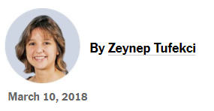
Example: Optimizing for maximum video viewing time may incentivize the display of alarming/intriguing information, whether or not it is true (propaganda)
Notes:
https://www.nytimes.com/2018/03/10/opinion/sunday/youtube-politics-radical.html
YouTube’s algorithm deciding what to display to viewers amplifies conspiracy theories/ fake news:
https://www.theguardian.com/technology/2018/feb/02/how-youtubes-algorithm-distorts-truth

Slide 71
Can your model be gamed?
Notes:
Unintended consequences
https://www.theguardian.com/technology/2018/mar/04/robots-screen-candidates-for-jobs-artificial-intelligence?CMP=twt_gu

Slide 72
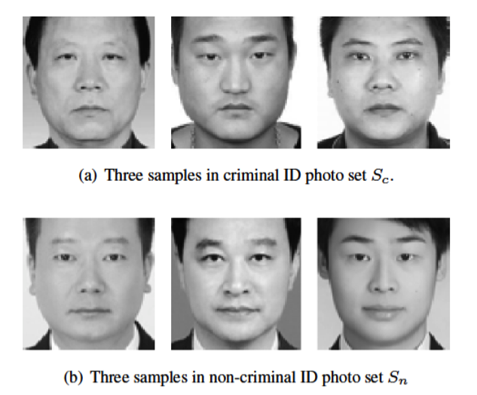
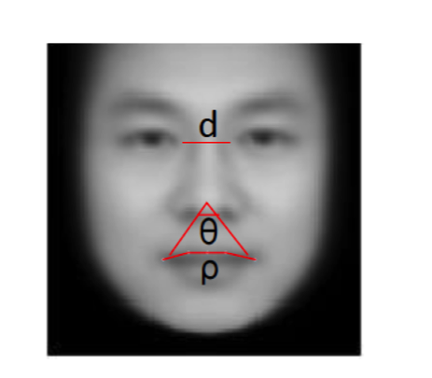
Are your results the equivalent of phrenology?
Notes:
audience participation……
-700 criminal photos from criminal database – IDs (not mugshots)
-1100 non-criminal photos from various sources
-could be white shirts, slight smile (“facial relaxation”), etc.
-skin color? Facial structure / ethnic group
-could be predicting who a jury was more likely to convict, not who was more likely a criminal (bias baked into process)
-Claimed 90% accuracy: but what type of error – false positives / false negatives? You could be falsely accusing a huge portion of the population of “looking” criminal.
-in the end, authors agreed about possible social biases related to socioeconomic status, and that “criminality” might be too strong a descriptor for what is detected
https://callingbullshit.org/case_studies/case_study_criminal_machine_learning.html

Slide 73
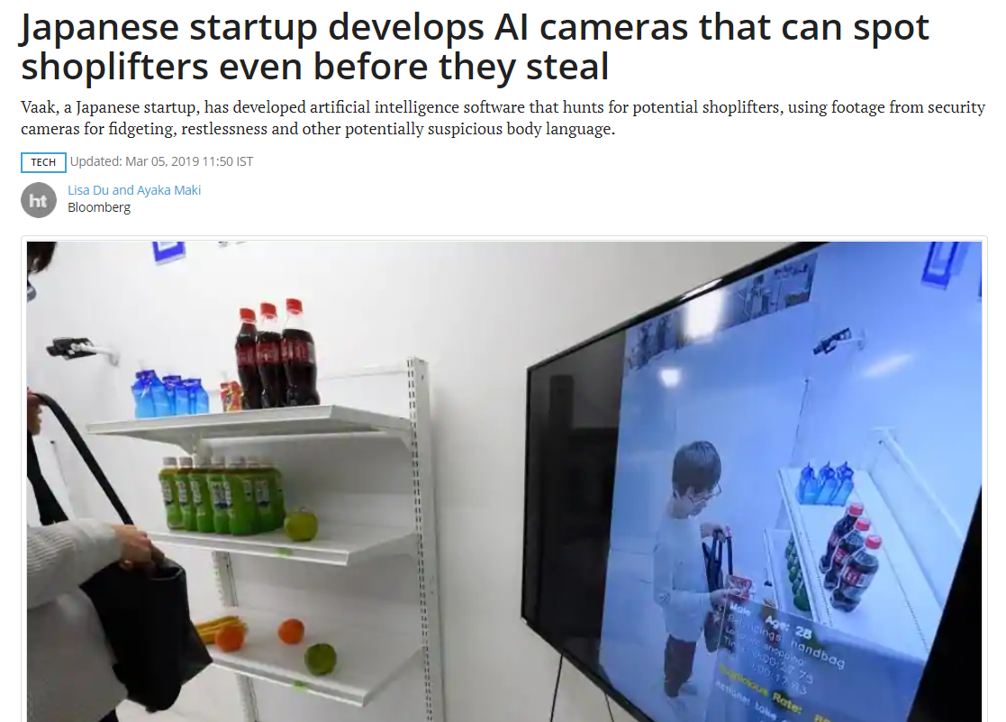
Minority Report “Pre-Crime”?

Slide 74
Feature & Algorithm Selection - Different algorithms handle different types of data in different ways
Target Selection/Optimization Goal - What are you optimizing for? (Technical & Business Decision)
Model Evaluation - How good does your model have to be to decide to stop improving it? And how do you define “good”? Consider “cost” of each type of error.
Notes:
Human decision-making is involved in every step

Slide 75
Implementing the Trained Model - In what scenarios can your model be applied? How generalizable is it?
Interpretation - How do you interpret the results? How do you document and explain to others how to interpret the results?
Maintenance - For how long can the current model be applied? When does the model need to be retrained? Does the “ground truth” change?
Notes:
Is everyone going to look at the results and come to the same conclusion?

Slide 76
Could your model cause harm?
Or perpetuate existing social hierarchies, preventing a fair playing field?

Slide 77
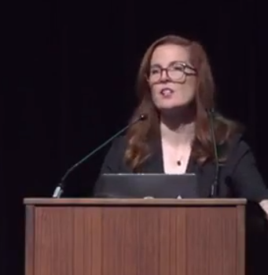
Some Types of Harm a Model Can Perpetuate
Allocative harms - resources are allocated unfairly or witheld (transactional, quantifiable)
Representational harms - systems reinforce subordination/perceived inferiority of some groups (cultural, diffuse, can lead to other types of harm)
stereotyping
underrepresentation
recognition
denigration
Ex-nomination
(from Kate Crawford’s talk at 2017 NIPS Conference, The Trouble With Bias)
Notes:
Recognition - group is erased by or invisible to a system
Denigration - offensive or culturally disparaging terms used to describe people (requires understanding of culture/history)
Exnomination - (like normalizing whiteness or upper-class by not naming it)
https://teamopendata.org/t/the-trouble-with-bias-kate-crawford-nips-2017/200

Slide 78
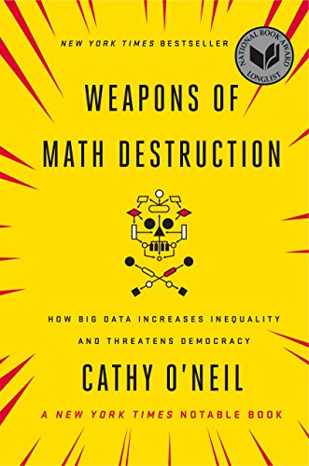
Notes:
Cathy O’Neil Weapons of Math Destruction
https://amzn.to/2HjnT0O

Slide 79
What makes a model a “Weapon of Math Destruction”?
Opacity - inscrutable “black boxes” (often by design)
Scale - capable of exponentially increasing the number of people impacted
“The privileged...are processed more by people, the masses by machines.”
Damage - can ruin people’s lives and livelihoods

Slide 80
So, Can a Machine Be Racist or Sexist?
Notes:
Which brings us to the central question of this talk...
(or discriminatory in other ways?)

Slide 81
YES

Slide 82
“...there is nothing “artificial” about [Artificial Intelligence] — it is made by humans, intended to behave like humans and affects humans. So if we want it to play a positive role in tomorrow’s world, it must be guided by human concerns.”
“...there are no “machine” values at all, in fact; machine values are human values.”
-Fei-Fei Li
How to Make A.I. That’s Good for People,
New York Times, 3/7/2018
Notes:
https://www.nytimes.com/2018/03/07/opinion/artificial-intelligence-human.html

Slide 83
What can we do about it?

Slide 84
Be aware of the potential for bias and disparate impact machine learning models can perpetuate (and help educate others)
Test for bias in your models & evaluate model performance on minority classes in your dataset
Evaluate possible uses (or misuses) of your model, and “perverse incentives” it may create in the system into which it’s being deployed
Improve transparency & explainability of how your model categorizes and predicts things (LIME)

Slide 85
Document Data Source & Transformation Pipeline to help manage data governance & provenance and allow reproducible research
Communicate context, and explain model generalization limits to end-users
Involve Domain Experts who know the history of the data collection, actual field definitions, data quality issues, system changes over time, how the model will likely be applied, ethical issues and laws in the field of application, etc.
Gather Representative Training Data

Slide 86
Include fairness as an optimization objective, add social bias penalties (research emerging, more needed)
Research and Develop new tools and techniques for detecting bias and reducing disparate impact caused by machine learning models
Build adversarial tools to stress-test your own models, and thwart others that are causing harm
Hire Diverse Teams
Demand Accountability and Regulation in the industry, and in your own organizations
Notes:
There could be a whole other talk on the definitions of “fairness” and how to incorporate into algorithms…
Note: don’t only count on minority members of team to do this work for you!

Slide 87
Report on the topic to help educate the public on how these things impact them, and hold companies accountable. Also support organizations like ProPublica who are doing this reporting as well
Algorithmtips.org – Computational Journalism Lab at Northwestern University
Stay up to date
Twitter list of 130 people & orgs who talk about ethics & law in AI
List of books about Bias in ML
Notes:
There could be a whole other talk on the definitions of “fairness” and how to incorporate into algorithms…
Note: don’t only count on minority members of team to do this work for you!

Slide 88
Organizations working on this
AI Now Institute at NYU https://ainowinstitute.org/
Algorithmic Justice League https://www.ajlunited.org/ (Watch Joy Buolamwini’s TED Talk!)
Data for Democracy, Bloomberg, BrightHive Data Science Code of Ethics http://datafordemocracy.org/projects/ethics.html
Fairness, Accountability, and Transparency in Machine Learning https://www.fatml.org/
Notes:
AI Now -“Fairness Forensics”
https://www.ted.com/talks/joy_buolamwini_how_i_m_fighting_bias_in_algorithms#t-106117
https://medium.com/mit-media-lab/the-algorithmic-justice-league-3cc4131c5148

Slide 89
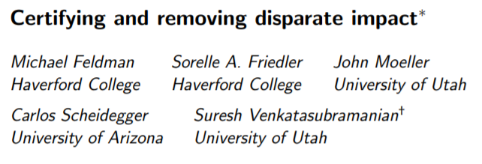
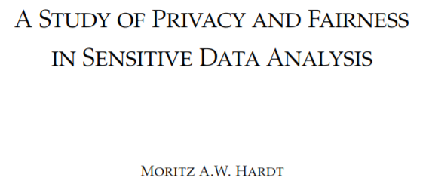
Example research
Notes:
https://arxiv.org/pdf/1707.09457.pdf
http://proceedings.mlr.press/v28/zemel13.html
https://dataspace.princeton.edu/jspui/bitstream/88435/dsp01vq27zn422/1/Hardt_princeton_0181D_10071.pdf
https://link.springer.com/content/pdf/10.1007%2F978-3-642-33486-3_3.pdf
https://arxiv.org/pdf/1412.3756.pdf

Slide 90
More resources
Flipboard Magazine where I collect articles on this topic:
https://flipboard.com/@becomingdatasci/bias-in-machine-learning-rv7p7r9ry
https://www.becomingadatascientist.com/2015/11/22/a-challenge-to-data-scientists/
https://developers.google.com/machine-learning/fairness-overview/
https://sloanreview.mit.edu/article/the-risk-of-machine-learning-bias-and-how-to-prevent-it/
https://www.fatml.org/resources/relevant-scholarship
https://twitter.com/random_walker/status/961332883343446017
Notes:
https://events.technologyreview.com/video/watch/timnit-gebru-ai-limits-algorithms-fail/
https://www.youtube.com/watch?time_continue=2793&v=fMym_BKWQzk
Twitter thread from 4/15 (after talk) with more links to ethicists & lawyers: https://twitter.com/BecomingDataSci/status/985187318402306048
https://twitter.com/BecomingDataSci/status/985199263054524419
Crowdsourced document with more: https://twitter.com/ruchowdh/status/984810052694487040

Slide 91
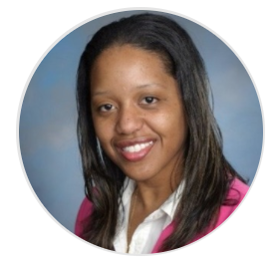
“How do we govern ourselves? How do we instill that trust in others that we as stewards of that data understand the power that we have, and want to make sure that we're doing right by the people who are trusting us with that data?”
-Natalie Evans Harris Data for Good Exchange 2017, Inside Bloomberg
Notes:
Natalie Evans Harris (originally scheduled panelist, BrightHive & Obama administration OSTP) worked w/team on Data Science Code of Ethics

Slide 92
Renée Teate, HelioCampus
Becoming A Data Scientist Podcast & Blog
@becomingdatasci
Notes:
How to find me (twitter & blog) – I’ll post my slides on the blog and tweet a link
My goal today was to get you to start thinking about the ways your work impacts people’s lives - and arm you with information you can use to discuss this topic at work, etc.
I hope I’ve inspired some of you in this room to further study this topic, teach it, research it. Consult ethicists, legal experts, sociologists and people who study social bias. At a minimum, start thinking about it and stop pretending that because a process is computerized, it’s suddenly fair and free of human bias.
This was an overview to get us onto the same page so we can discuss further, let’s talk to our panel

